Slide 1


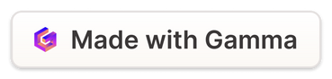
Relationships in Database Management
Presentation By: Kirtika Rana Khand
Course Title: Database Management System
Unit Title : Relationship Types and Sets
Subject Teacher : Sanjeev Thapa
Date: 2025/01/19

Slide 2
RELATIONSHIP
Q] What is a Relationship in DBMS?
A relationship is a logical connection or association between two or more entities in a database.
It helps to define how data in one table relates to data in another, forming a network of interconnected information.
Q] Why Relationships Matter:
Data Organization:
Ensures data is stored efficiently and logically for easy access and analysis.
Consistency:
Relationships enforce rules, such as foreign key constraints, to maintain data integrity.
Real-World Modeling:
Accurately represents real-world scenarios (e.g., employee-to-department assignments).
Query Simplification:
Relationships make it easier to retrieve related data.

Slide 3
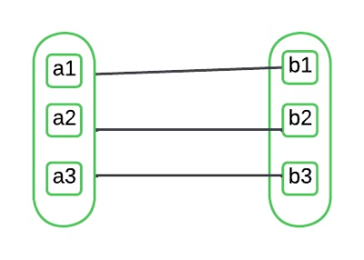
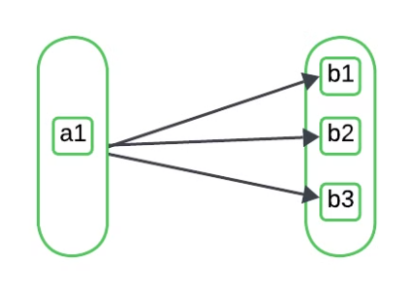
Types of Relationships in DBMS
1.One-to-One (1:1)
2.One-to-Many (1:M)
Definition: Each entity in one table is associated with exactly one entity in another table.
Definition: One entity in a table is associated with multiple entities in another table.
Example:
Example:
Entity A: Citizen
Entity A: Teacher
Entity B: Passport
Entity B: Students
A specific citizen has one Passport, and an Passport is assigned to one specific person.
A Teacher teaches many students, but each student is taught by only one teacher.

Slide 4
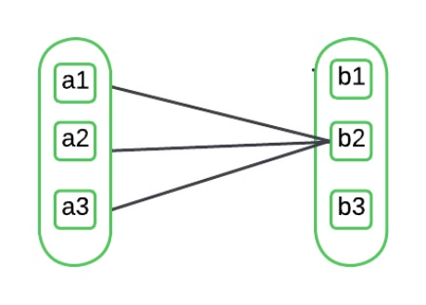
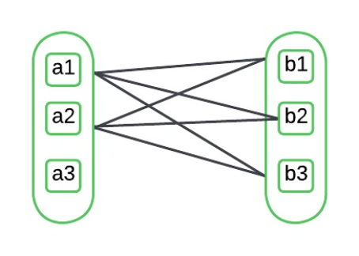
3.Many-to-One (M:1)
4.Many-to-Many (M:N)
Definition: Multiple entities in one table are associated with a single entity in another table.
Definition: Entities in set A can be associated with multiple entities in set B and vice versa.
Example:
Example:
Entity A: Order
Entity A: Students
Entity B: Customer
Entity B: Courses
Many order can be placed by single customer
A student can enroll in multiple courses, and a course can have many students.

Slide 5
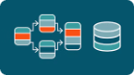
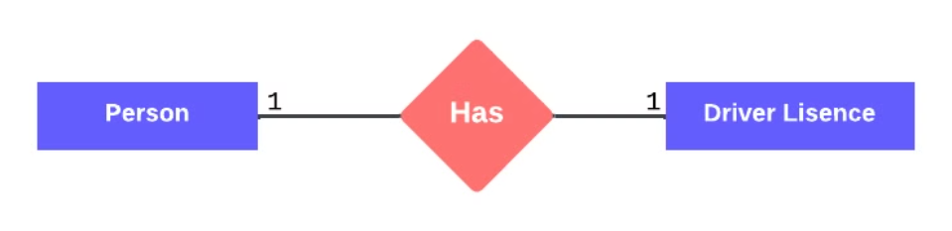

Real-World Implications of Relationship Types
One-to-One:
Used in systems where strict one-to-one mapping is required, e.g., passports and citizens. Attributes of Person: Person_ID (Primary Key), Name, Date_of_Birth , Address. Attributes of Driver Lisence:License_ID (Primary Key), License_Number , Issue_Date , Expiry_Date, Person_ID (Foreign Key)
One-to-Many:
Common in hierarchical structures like company departments and employees. Attributes of School: School_ID (Primary Key), Name, Location. Attributes of Students: Student_ID (Primary Key), Name, Grade, School_ID (Foreign Key).

Slide 6

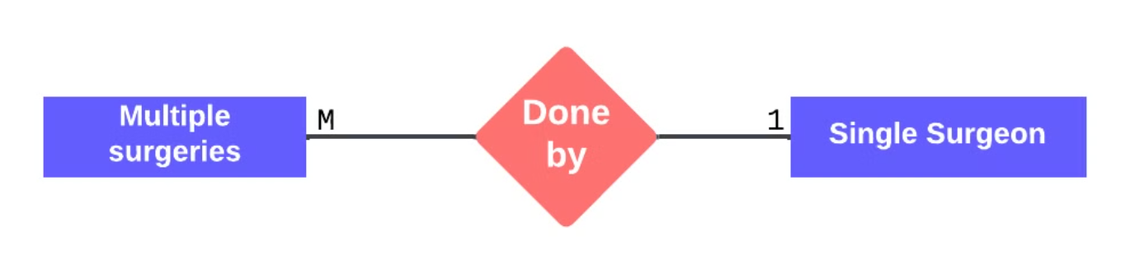
Many-to-Many:
Used in collaborative systems, e.g., library books and borrowers, or teachers and subjects. . Attributes of Student: Student_ID (Primary key) , Name , Date_of_Birth, Email. Attributes of Course: Course_ID (Primary key) , Course_Name , Credit, Instructor.
Many-to-one
Used in collaborative systems, e.g., library books and borrowers, or teachers and subjects. Attributes of Surgeries: Surgery_ID (Primary Key), Surgery_Type, Patient_Name, Date, Surgeon_ID (Foreign Key). Attributes of Surgeon: Sugeon_ID (Primary key) , Name , Specialization, Experience, Contact

Slide 7
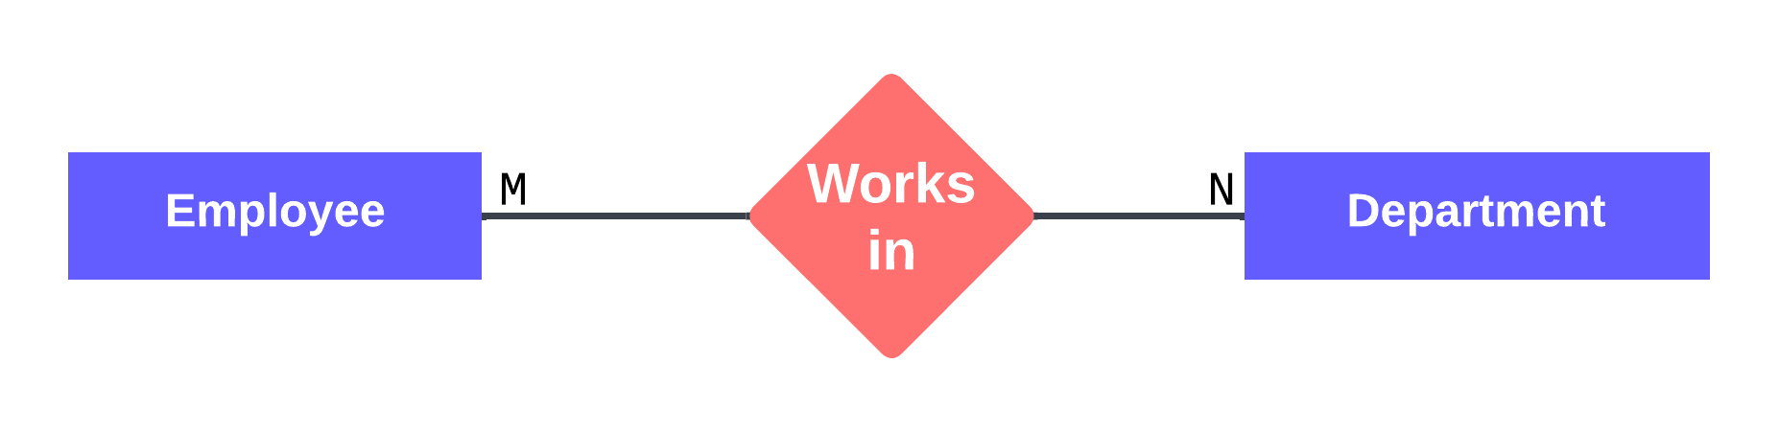
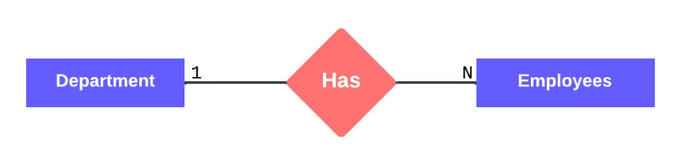
Diagram: Employee-Department Relationship
Relationship : Department to Employee
Relationship : Employee to Department
Entities: Employee, Department
Entities: Employee, Department
Type: One-to-Many
Type: Many-to-Many
Description: A single department can have multiple employees.
Description: An employee can belong to multiple departments, and each department can have multiple employees
Attributes.
Attributes of Employee: Employee_ID (Primary Key),Name, Position.
Attributes of Department:Department_ID (Primary Key), Department_Name, Location

Slide 8
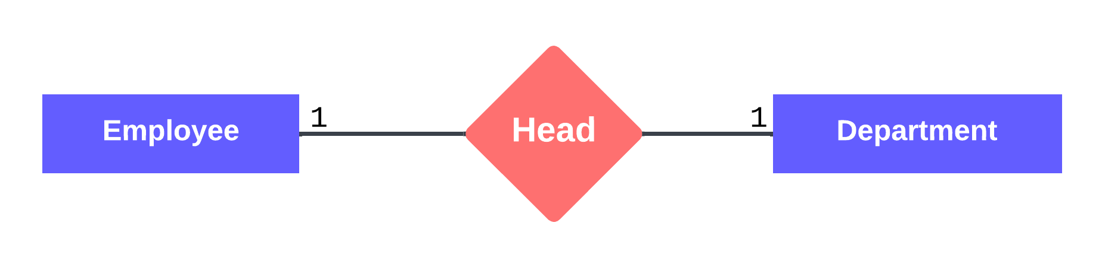
Relationship : Employee to Department
Entities: Employee, Department
Type: One-to-one
Description: Each department has one employees as its head.

Slide 9
Conclusion
Relationships form the backbone of scalable and flexible database systems, allowing them to adapt to growing business needs, support advanced data analysis, and drive informed decision-making. Without relationships, databases would be disjointed and less efficient, limiting their ability to manage and represent real-world scenarios effectively.

Slide 10

Thank you!
I appreciate your time and attention.

